Slide 1
Diabetes Prediction Using SQL
By Shubhangi Deokar

Slide 2
Project Description-
Diabetes has become a prevalent health concern worldwide, affecting millions of individuals. It is a chronic health condition characterized by elevated levels of sugar (glucose) in the blood.
Type 1- typically diagnosed in childhood or adolescence, results from the immune system attacking insulin-producing cells.
Type 2- often linked to lifestyle factors, involves insulin resistance or insufficient insulin production. Prolonged high blood sugar levels can lead to various complications affecting the heart, kidneys, eyes, and nerves.
Aim -
This project aims to develop data-driven decisions for identifying the risk of diabetes in individuals based on their health parameters using SQL data analysis techniques.
Objective -
1) This project aims to leverage SQL's power for efficient data handling and analysis, enabling early prediction of diabetes, its complications, likelihood of an individual developing diabetes based on various health parameters.
2) To help healthcare professionals in identifying individuals at higher risk of diabetes and help in medication, lifestyle sugar levels to prevent complications and thereby facilitating proactive healthcare measures for affected individuals and maintain overall health.
3) Early identification and intervention can significantly mitigate the risks associated with this chronic condition.

Slide 3
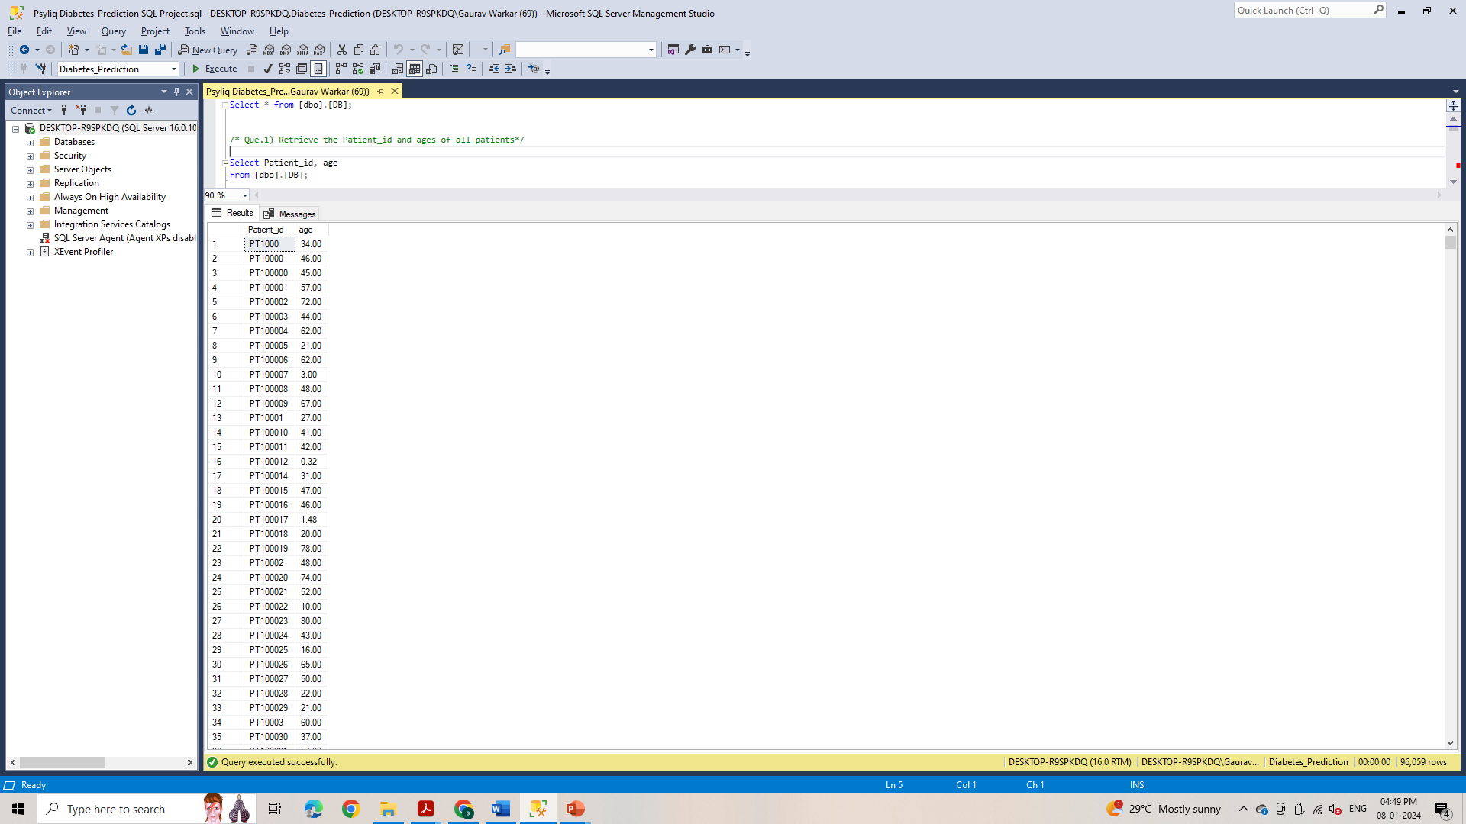
1. Retrieve the Patient_id and ages of all patients.
Query : Select Patient_id, age
From [dbo].[DB];

Slide 4
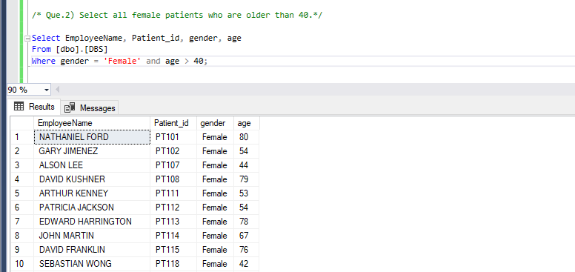
2. Select all female patients who are older than 40.
Query : Select EmployeeName, Patient_id, gender, age
From [dbo].[DB]
Where gender = 'Female' and age > 40;

Slide 5
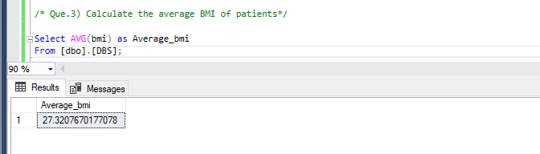
3. Calculate the average BMI of patients.
Query : Select AVG(bmi) as Average_bmi
From [dbo].[DB];

Slide 6
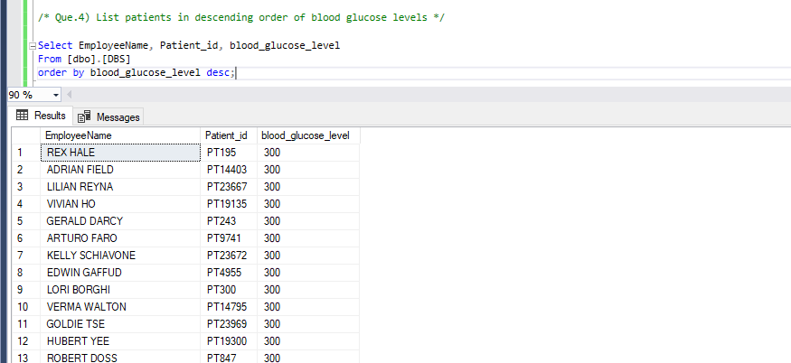
4. List patients in descending order of blood glucose levels.
Query : Select EmployeeName, Patient_id, blood_glucose_level
From [dbo].[DB]
Order by blood_glucose_level desc;

Slide 7
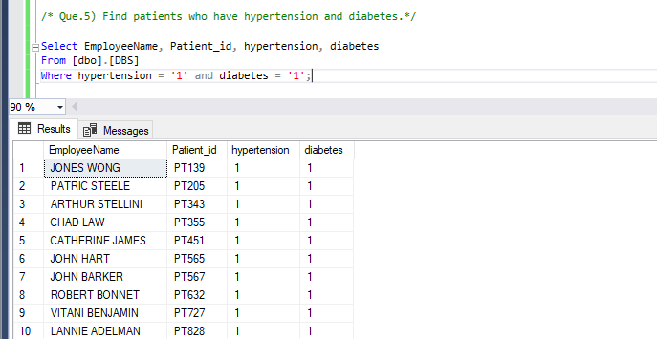
5. Find patients who have hypertension and diabetes.
Query : Select EmployeeName, Patient_id, hypertension, diabetes
From [dbo].[DB]
Where hypertension = '1' and diabetes = '1';

Slide 8
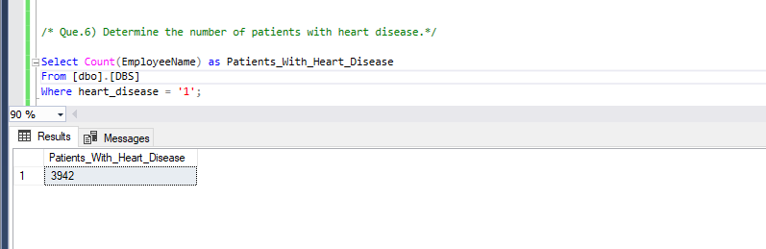
6. Determine the number of patients with heart disease.
Query : Select Count(EmployeeName) as Patients_With_Heart_Disease
From [dbo].[DBS]
Where heart_disease = '1';

Slide 9
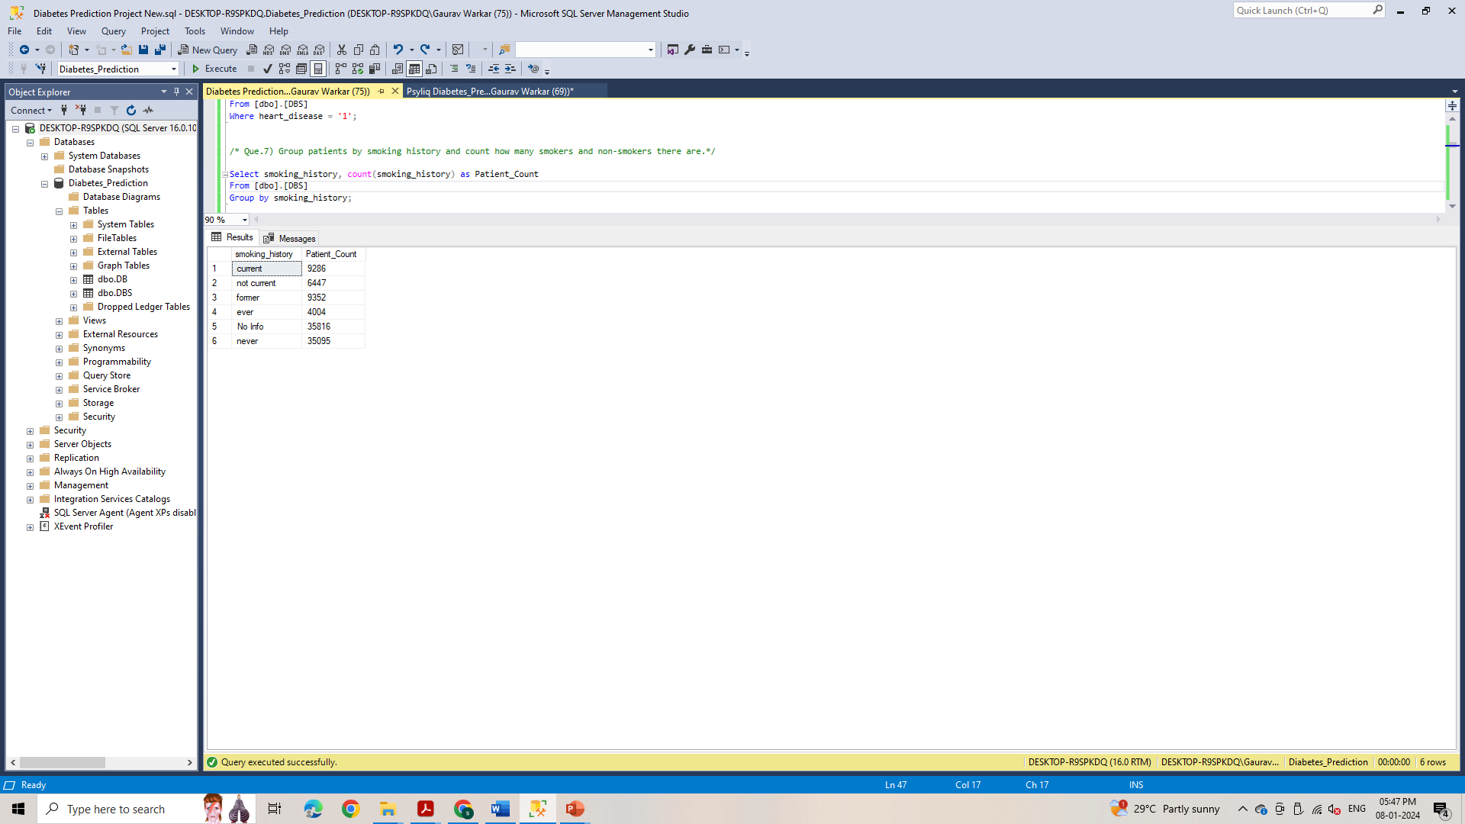
7. Group patients by smoking history and count how many smokers and non-smokers there are?
Query : Select smoking_history, count(smoking_history) as Patient_Count
From [dbo].[DBS]
Group by smoking_history;

Slide 10
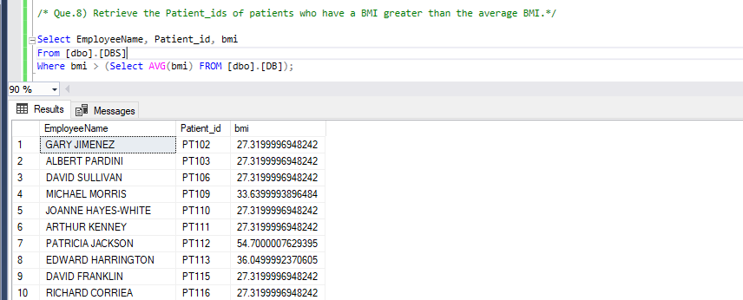
8. Retrieve the Patient_ids of patients who have a BMI greater than the average BMI.
Query : Select EmployeeName, Patient_id, bmi
From [dbo].[DBS]
Where bmi > (Select AVG(bmi) FROM [dbo].[DB]);

Slide 11
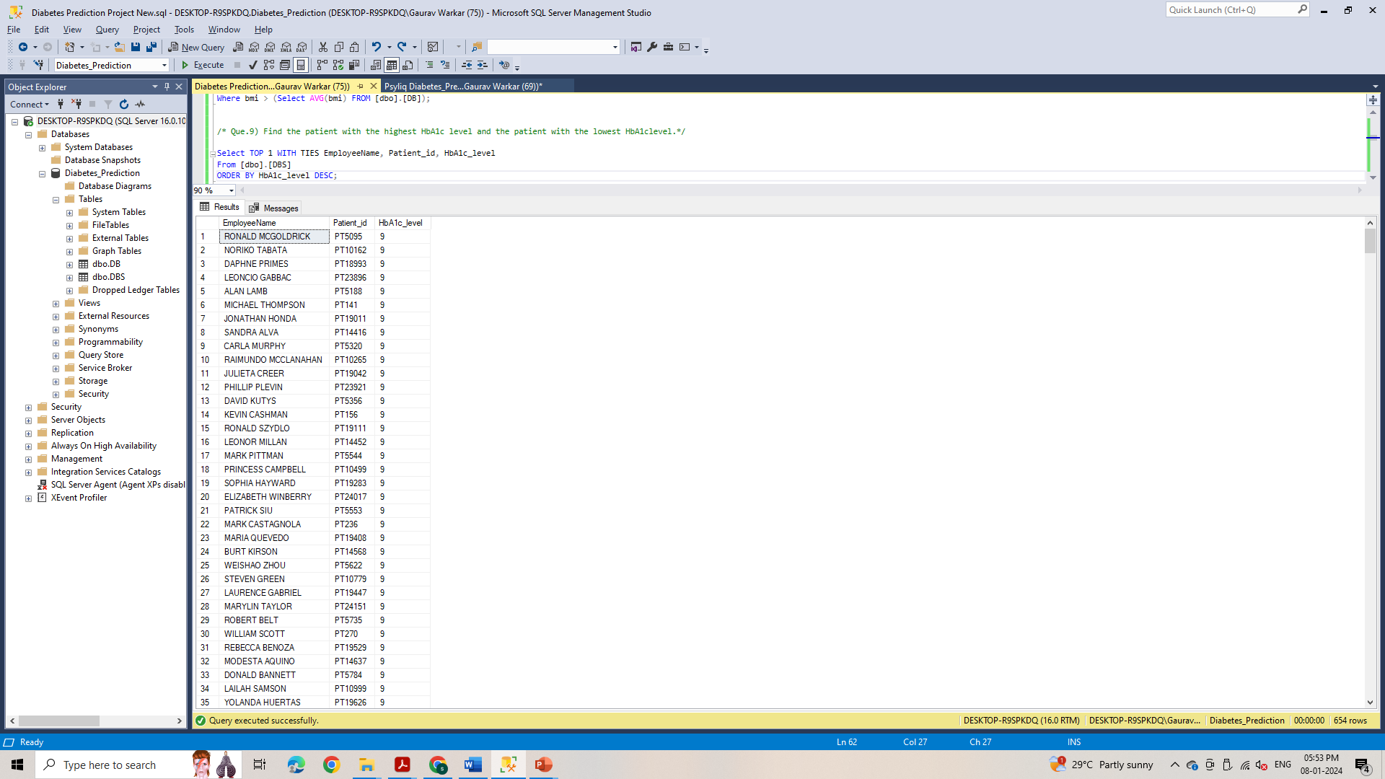
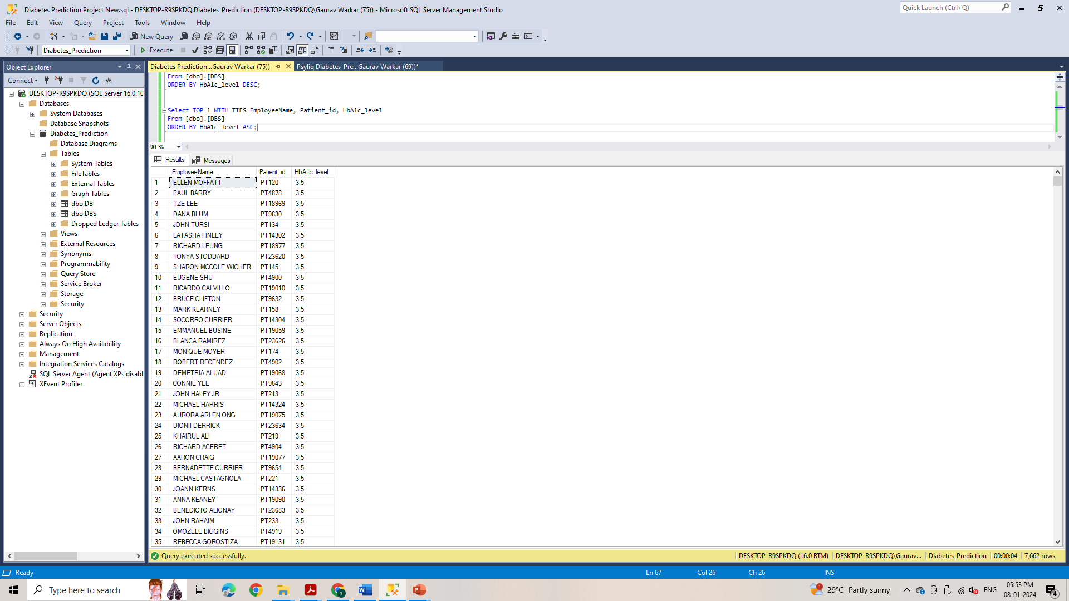
9. Find the patient with the highest HbA1c level and the patient with the lowest HbA1clevel.
Query : Select TOP 1 WITH TIES EmployeeName, Patient_id, HbA1c_level
From [dbo].[DBS]
ORDER BY HbA1c_level DESC;
Query : Select TOP 1 WITH TIES EmployeeName, Patient_id, HbA1c_level
From [dbo].[DBS]
ORDER BY HbA1c_level ASC;

Slide 12
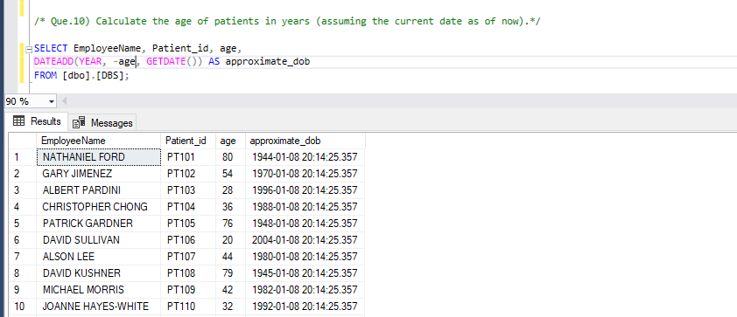
10. Calculate the age of patients in years (assuming the current date as of now).
Query : SELECT EmployeeName, Patient_id, age,
DATEADD(YEAR, -age, GETDATE()) AS approximate_date_of_birth
FROM [dbo].[DBS];

Slide 13
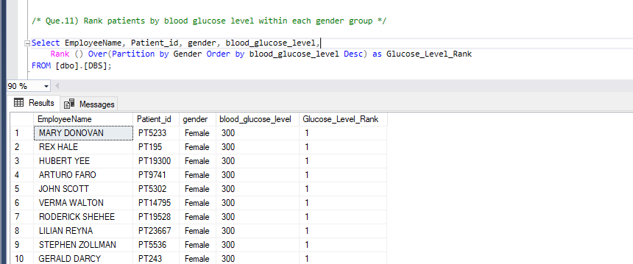
11. Rank patients by blood glucose level within each gender group
Query : Select EmployeeName, Patient_id, gender,blood_glucose_level,
Rank () Over(Partition by Gender Order by blood_glucose_level Desc) as Glucose_Level_Rank
FROM [dbo].[DBS];

Slide 14
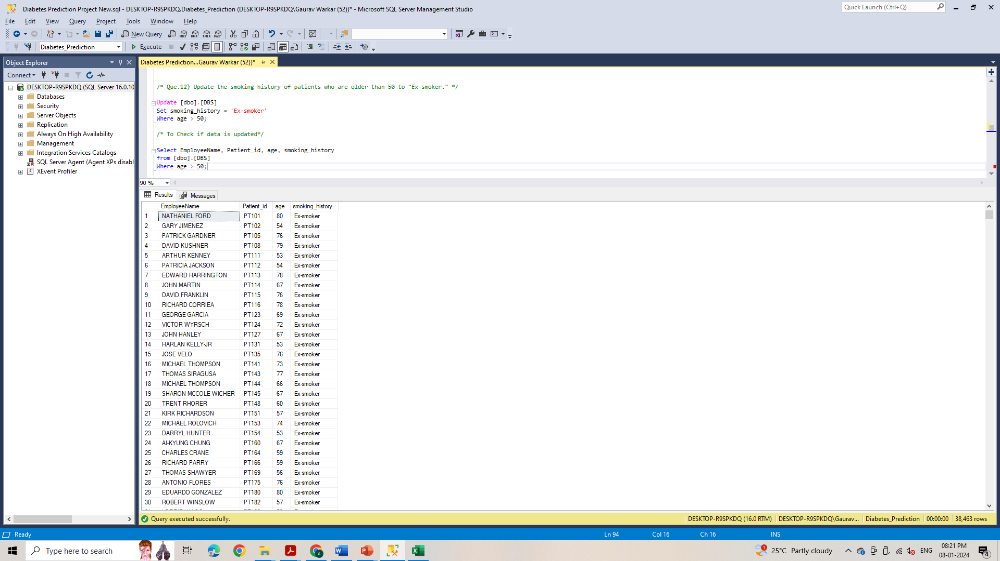
12. Update the smoking history of patients who are older than 50 to "Ex-smoker."
Query : Update [dbo].[DBS] Set smoking_history = 'Ex-smoker’ Where age > 50;
/* To Check if data is updated*/
Select EmployeeName, Patient_id, age, smoking_history
from [dbo].[DBS]
Where age > 50;

Slide 15
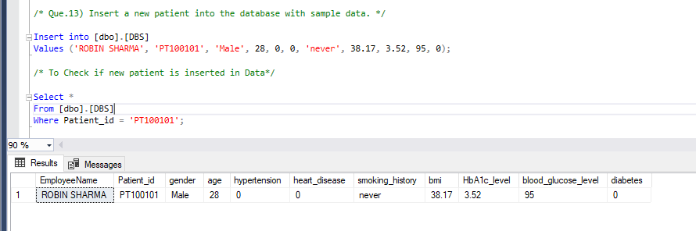
13. Insert a new patient into the database with sample data.
Query : Insert into [dbo].[DBS]
Values ('ROBIN SHARMA', 'PT100101', 'Male', 28, 0, 0, 'never', 38.17, 3.52, 95, 0);
/* To Check if new patient is inserted in Data*/
Select *
From [dbo].[DBS]
Where Patient_id = 'PT100101';

Slide 16
14. Delete all patients with heart disease from the database.
Query : Delete from [dbo].[DBS]
Where heart_disease = 1;
/* To Check if we have deleted all patients with heart disease*/
Select *
From [dbo].[DBS]
Where heart_disease = 1;

Slide 17
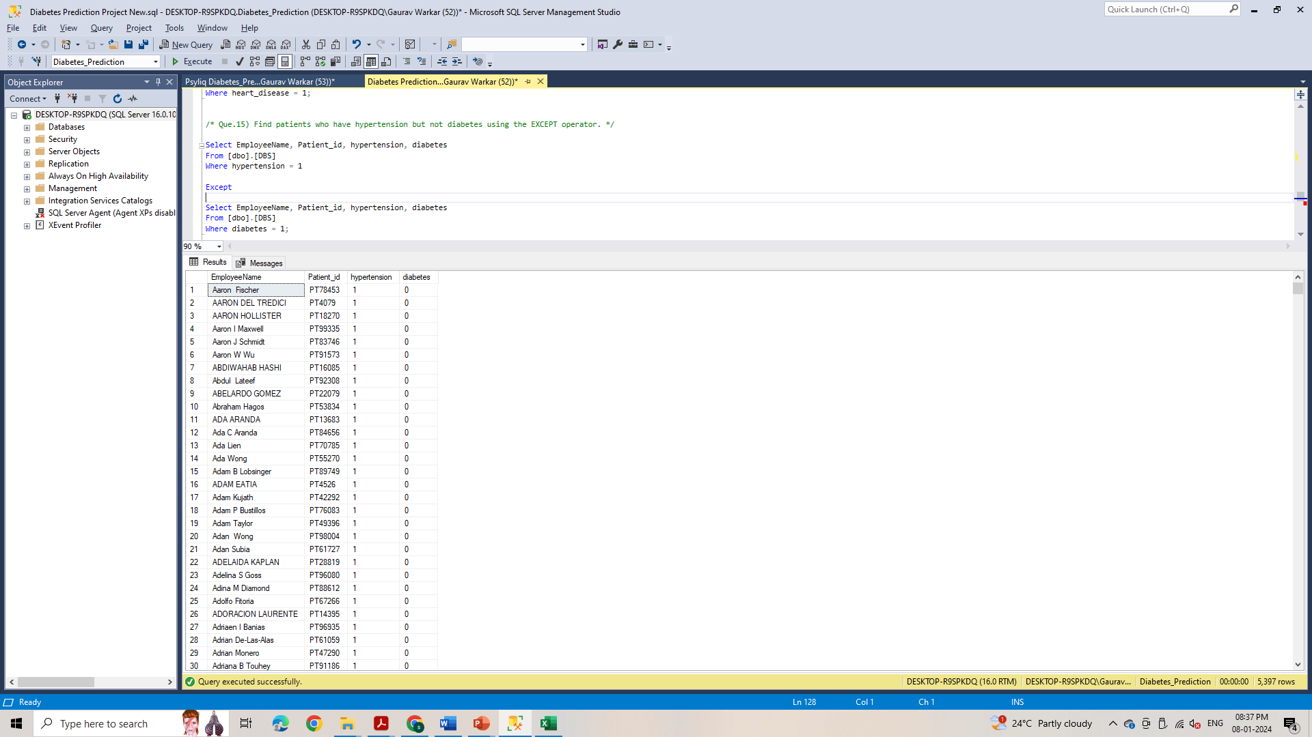
15. Find patients who have hypertension but not diabetes using the EXCEPT operator.
Query : Select EmployeeName, Patient_id, hypertension, diabetes
From [dbo].[DBS]
Where hypertension = 1
Except
Select EmployeeName, Patient_id, hypertension, diabetes
From [dbo].[DBS]
Where diabetes = 1;

Slide 18
16. Define a unique constraint on the "patient_id" column to ensure its values are unique.
Query : Alter Table [dbo].[DBS]
Add Constraint unique_patient_id UNIQUE (patient_id);

Slide 19

17. Create a view that displays the Patient_ids, ages, and BMI of patients.
Query : CREATE VIEW Patient_info
As
Select Patient_id, age, bmi
From [dbo].[DBS];
/* To Check if table has been created or not. */
Select * from Patient_info;

Slide 20
18. Suggest improvements in the database schema to reduce data redundancy and improve data integrity.
1) Normalize tables into third normal form (3NF) by splitting large tables into smaller ones, minimizing redundant data storage.
2) Use proper data types and constraints
3) Use Foreign keys and Joins to establish relationships.
4) Indexing: Create indexes on columns frequently used in queries to improve query performance.
5) Remove unused data
6) Regular Maintenance: Schedule regular database maintenance to remove unnecessary data, optimize indexes, and ensure smooth operation.

Slide 21
19. Explain how you can optimize the performance of SQL queries on this dataset.
1. Limit the Number of Rows Returned:-
Use the LIMIT clause to restrict the number of rows returned, especially when working with
large datasets. It significantly enhances query response times.
2. Implement Indexing:-
Create indexes on columns frequently used in WHERE clauses and join conditions. This can
significantly speed up query execution.
3. Optimize JOIN Operations:-
Be mindful of how you structure your joins. Selecting appropriate join types(INNER, LEFT, etc.)
based on specific requirements.
4. Avoid Unnecessary SELECT :-
Instead of using SELECT *, explicitly list only the columns you need. This reduces the amount
of data transferred and can improve query performance.
5. Effective Utilization of WHERE Clauses :-
Filter rows as early as possible in the query execution process by using efficient WHERE
clauses. Avoid unnecessary conditions.
6. Partitioning:-
If your dataset is large, consider partitioning tables based on certain criteria (e.g., date ranges).
This can improve query performance by narrowing the scope of data to be searched.
7. Use Stored Procedures:-
Use stored procedures to encapsulate and optimize frequently executed

Slide 22
Thanks

